Slide 1
UEN002 – Energy and Environment
In the previous session…
We went through the course objectives, contents, outcomes, recommended books and the evaluation pattern.

Slide 2
Episodes of Environmental and Health impacts that are examples of Immense Human Error and Negligence
True life case studies that resulted in environmental and health impact of immense magnitude:
Bhopal Gas Tragedy (https://www.youtube.com/watch?v=rJg19W8x_Ls&t=2s)
Love Canal Tragedy (https://www.youtube.com/watch?v=3iSFgZ-SlaU&t=11s)
Beas river pollution (https://www.youtube.com/watch?v=8VE_OpIbyc8)
Case studies through self-study mode:
Chernobyl nuclear disaster (https://www.youtube.com/watch?v=eB1vfga9Y_c)
Seveso industrial chemical leak (https://www.youtube.com/watch?v=zkvdM3RlGFU)

Slide 3
Bhopal Gas Tragedy

Slide 4
Bhopal and Union Carbide Subsidiary
Union Carbide Corporation, USA: Indian subsidiary Union Carbide India Ltd (UCIL), Bhopal, 1934
Carbaryl Production
Reaction:
Monomethylamine+ phosgene Methyl Isocyanate (MIC)
Methyl Isocyanate (MIC)+alpha Napthol Carbaryl
Maximum permissible limit for MIC storage: half a ton

Slide 5
Mishap
Operator was asked to wash the piping around one of the three MIC storage tanks at 10.15 pm Sunday, December 2, 1984, suspecting a leak
Valve of the tank was blinded off to prevent ingress of water, as it would initiate an exothermic polymerization reaction
At 11 pm, an increase in pressure was observed in the tank
At around 11.30 pm, operator sensed irritation in eyes, due to the leak of MIC

Slide 6
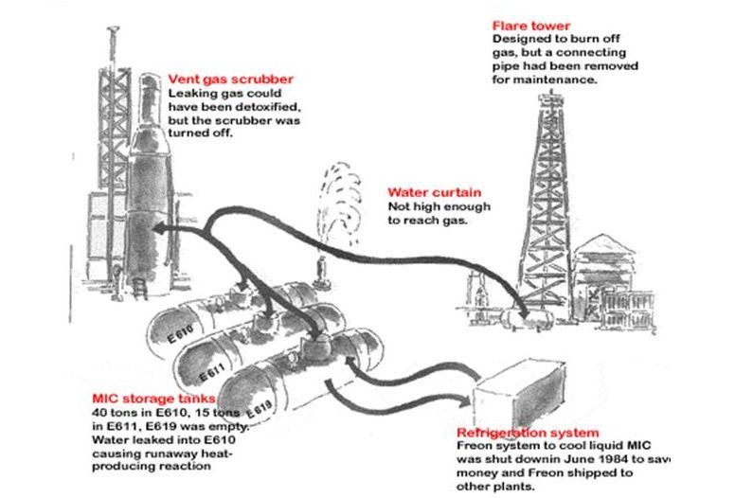
Technical Flaws that led to the Tragedy
Increase in temperature and pressure, led to the lifting of relief valve and MIC vapour discharged
Protective equipments were either out of order or not in full working order
Refrigeration system was shut down
Scrubbing system was not immediately available
Flare system was out of use

Slide 7
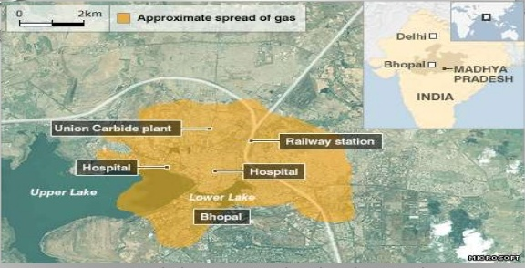
The Disaster
At midnight, due to the built up of excessive pressure, the rupture disk burst and blew off the safety valve and MIC escaped into the atmosphere through vent line.
Early hours of December 3, 1984
Immediate death: 8,000
Permanent disability: 250,000
After 14 yrs, death toll: 16,000
Continuous Suffering: 120,000

Slide 8
Health Hazard of Bhopal Gas Tragedy
Pulmonary edema was the cause of death in most cases, with many deaths resulting from secondary respiratory infections such as bronchitis and bronchial pneumonia
Other effects noted from acute inhalation exposure to methyl isocyanate in humans are
respiratory tract irritation, difficulty breathing, blindness, nausea,
gastritis, sweating, fever, chills, and damage to liver and kidney
Survivors continue to exhibit damage to the lungs (e.g., bronchoalveolar lesions and decreased lung function) and the eyes (e.g., loss of vision, loss of visual acuity, and cataracts)

Slide 9
Health Hazard of Bhopal Gas Tragedy
Unusually, high percentage of survivors had disorders of the reproductive system, including leukorrhea, pelvic inflammatory disease, excessive menstrual bleeding, and suppression of lactation.
Other adverse effects included increases in the number of stillbirths, spontaneous abortions, and increased infant mortality

Slide 10
Management Apathy
Chief Medical Officer and Works Manager of UC: MIC is an acute irritant, but certainly not lethal
Director of Health, Safety and Environment of UC: a potent tear gas, nothing more than that
MD of UC: unexplained incident
Medical Professionals: technical information and possible antidotes
Investigation and Enquiry: no system safety engineering and management established and practised in UC, at Bhopal, inspite of having a Directorate of Health, Safety and Environmental Affairs
Entire disaster: no parallel in world history

Slide 11
Errors committed by the Management
Adequate in built safety systems: not provided
Failure of Five safety systems: Vent gas scrubber, flare stack, water curtain, refrigeration system and spare storage tank
Safe operating procedures were not laid out and followed under strict supervision
Total lack of on-site and off-site emergency control measures
No hazard and operability study (HAZOP) was carried out on the design and no follow up by any risk analysis
Evacuation drills for fire and release of toxic gases were never held and practiced
Local authorities: never informed of hazard, danger signals and warnings

Slide 12
Errors committed by the Management
As part of UCC's drive to cut costs, the work force in the Bhopal factory was brought down by half from 1980 to 1984.
This had serious consequences on safety and maintenance. The size of the work crew for the MIC plant was cut in half from twelve to six workers.
The maintenance supervisor position had been eliminated and there was no maintenance supervisor.
The period of safety-training to workers in the MIC plant was brought down from 6 months to 15 days.

Slide 13
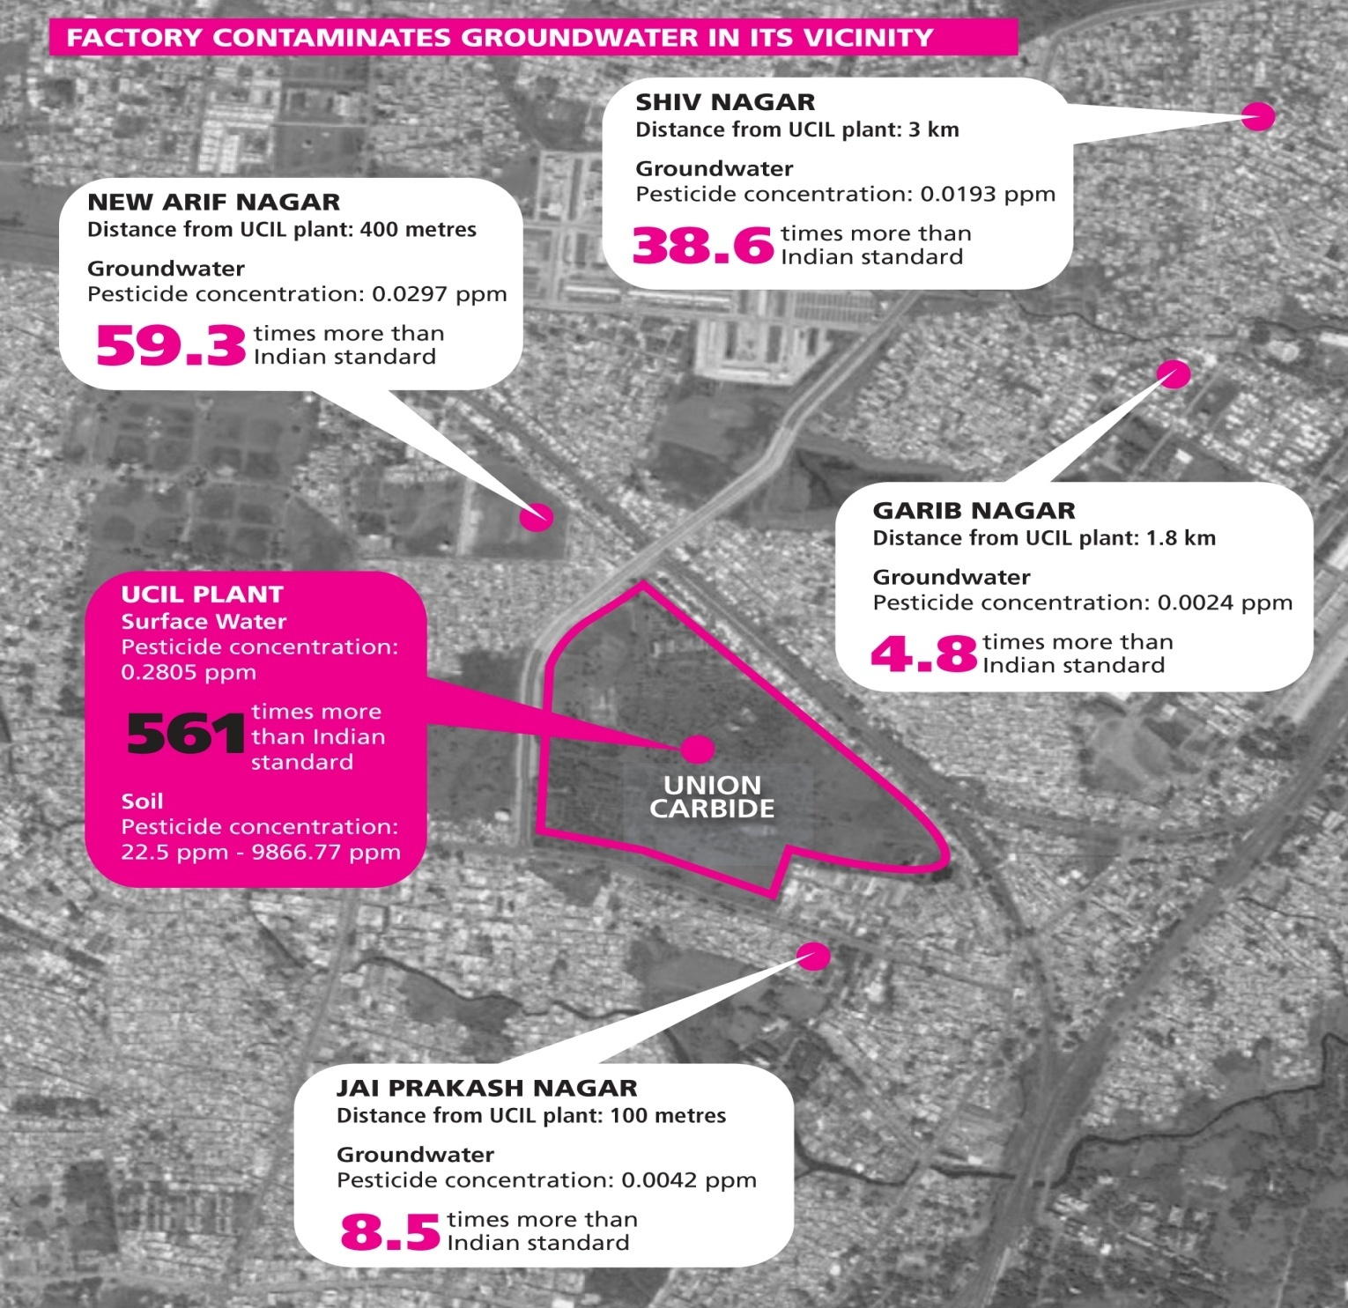
Ground Water Contamination

Slide 14
Safety Measures in UCC Plants - the USA and India
 | West Virginia, USA | Bhopal, Madhya Pradesh, India
Capacity | High production of MIC matched with high processing capacity. MIC not stored for long periods of time. | High production capacity of MIC but low processing capacity. MIC stored in large quantities for long periods of time.
Emergency scrubbers | MIC storage tank equipped with emergency scrubbers designed to operate under emergency conditions | No emergency caustic scrubber to neutralize any MIC leak.
Computerized monitoring | Computerized monitoring of instruments (gauges, alarms, etc) and processes to support visual observation. | No computerized monitoring of instruments and processes. Relied solely on manual observation.
Cooling system | MIC field storage tanks used a cooling system based on chloroform (inert and nonreactive with MIC). | MIC tanks used a cooling system based on brine (highly reactive with MIC).
Refrigeration unit | Refrigeration unit to control temperature in the tanks was never turned off. | Refrigeration unit had been turned off since June 1984.
Nitrogen pressure | MIC was always maintained under nitrogen pressure. | MIC tanks had not been under nitrogen pressure since October 1984.

Slide 15
 | West Virginia, USA | Bhopal, Madhya Pradesh, India
Emergency plan | An elaborate four-stage emergency plan to deal with toxic releases, fires, etc, including a general public alert linked to community police, river and rail traffic and local radio stations. Various emergency broadcast systems in place to alert and disseminate appropriate information to the public. | No system to inform public authorities or the people living adjacent to the plant. No emergency plan shared with communities living adjacent to the plant; no system to disseminate information regarding emergency to the public with the exception of a loud siren.
Maintenance programme | A maintenance programme to determine and evaluate replacement frequency for valves and instrumentation and alarm systems. Weekly review of safety valves and reviews and maintenance recorded extensively. | No evidence of an effective instrument maintenance programme. Safety valve testing programme largely ineffective and no proper records maintained of reviews of instruments, valves and alarm systems, etc.
Lab analysis | A lab analysis of MIC was conducted to test quality and check for contamination prior to storage, processing or distribution. | No lab analysis of quality was undertaken. MIC stored for long periods without testing for contamination.
Training | Extensive employee training programme to ensure high level of training and information among all employees of normal and emergency procedures. | Operators put in charge without sufficient training.
Protective equipment | Extensive provision of appropriate personal protective equipment to employees including protective clothing, air respirators, etc. | Personal protective gear and breathing air equipment not easily accessible, inadequate and of poor quality.

Slide 16
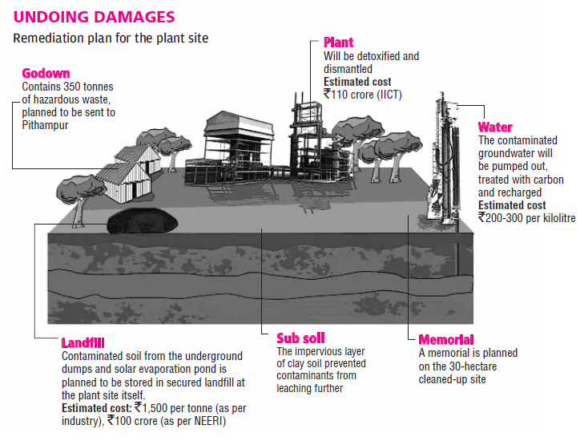
Remediation Plan

Slide 17
Bhopal Gas Tragedy Aftermath:
Development of Environmental Policy in India
Following the Bhopal gas leak the Factories Act of 1948 was amended and a new chapter on Hazardous Industries added in 1987.
This amendment also incorporated some of the Supreme Court pronouncements on industrial safety made in the context of an oleum gas leak in New Delhi in 1986.
In 1985 the Government of India enacted the Bhopal Gas Claims Act and appropriated to itself the sole privilege of representing the victims of the disaster.
The Act also laid down an elaborate mechanism of processing victims’ claims for compensation including medical categorisation.

Slide 18
Lessons to be Learnt….
Wherever and whenever possible, we should reduce or eliminate inventories of hazardous materials, in process and in storage
An alternative to intermediate storage is substitution, i.e., using a safer material or route, especially when reducing inventories, or intensification as it is called, is not practicable.
Just as “ materials which are not there cannot leak,” “people who are not there cannot be killed”

Slide 19
Lessons to be Learnt (contd…)
Keep protective equipment in working order and size it correctly
Safe operating procedures are to be maintained on regular schedule
Training in Loss Prevention
Handling ‘on-site’ and ‘off site’ emergencies
For major hazard installations like the Bhopal plant, hazard and operability study (HAZOP) should be carried out on the design as it is a powerful tool for identifying routes by which contamination and other unwanted deviations can occur.

Slide 20
In the next session…..
Other true life case studies that resulted in environmental and health impact :
Love Canal Tragedy
Beas river pollution

